Slide 1
Helicopter Vibration and RTB
Jim Fackler, Helicoptger Technology Company
5 MAR 2019
Atlanta GA

Slide 2
Overview
Machines and Vibration Overview
What is vibration?
Displacement
Mils (.001 inch) peak to peak
G
Change in direction
Velocity
Speed through zero crossing
Phase
When it happens in a cycle

Slide 3
Vibration Basic
Vibration is the oscillation of an object having a forcing function.
The oscillation may be periodic or random
Out of balance is periodic
Most aerodynamic functions are periodic
White noise (ex continuous combustion) is random

Slide 4
Vibration Basic

Slide 5
Vibration Basic – The sine wave

Slide 6
High Frequency Vibration

Slide 7
Vibration Basic
Vibration is the oscillation of an object having a forcing function.
The oscillation may be periodic or random
Out of balance is periodic
Most aerodynamic functions are periodic
White noise (ex continuous combustion) is random

Slide 8
Vibration Basic
Vibration is the oscillation of an object having a forcing function.
The oscillation may be periodic or random
Out of balance is periodic
Most aerodynamic functions are periodic
White noise (ex continuous combustion) is random

Slide 9
Basic Aerodynamics
The forces acting on a helicopter blades are the same as those acting on an airplane wing, but with different consequences

Slide 10
Blade Dynamics
FLAP
PITCH
LEAD / LAG

Slide 11
BLADE TRACK
TIP PATH
VERTICAL FORCES

Slide 12
STROBEX TRACK
TIMED FLASH FROM TRIGGER ON SWASHPLATE

Slide 13
STROBEX TIP TARGET

Slide 14
OPTICAL TRACKER
PASSIVE OBSERVATION OF BLADE SHADOW THROUGH A ‘GATE’

Slide 15
OPTICAL TRACK PRESENTATION

Slide 16
PROS /CONS OF TRACK AND TRACK DEVICES
TRACKING FLAG
PROS
Inexpensive. Easy to interpret
CONS
Can only be used on ground. Hazardous in gusty winds.
Require two crew members
Unlikely to resolve track to a smooth ride

Slide 17
PROS /CONS OF TRACK AND TRACK DEVICES
STROBEX
PROS
“Live” unprocessed image. Easy to interpret. Can be used in any flight or ground mode. May be used independently of processor.
CONS
Track “targets” may affect blade flight. Target material may erode in rain.
Does not input to processor for archive or solution generation.
Chance a good track does not result in a good ride.
Difficult to see in some lighting conditions

Slide 18
PROS /CONS OF TRACK AND TRACK DEVICES
OPTICAL TRACKER
PROS
Accurate when working properly. Passive – no need to attach targets. Can be archived. Very good at diagnosing lead / lag problems
CONS
Subject to optical errors. Processed image may not show transient events.
If track data is in error and the solutions are generated based on optical track image, success in track and balance is doubtful.
Handheld ones are subject to errors due to aircraft motion.
Good tip path ay not be best ride.

Slide 19
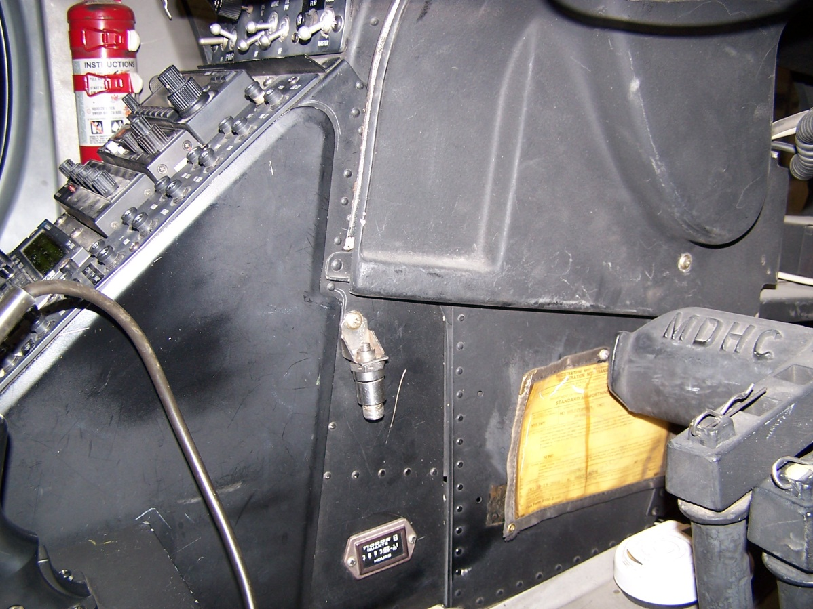
VERTICAL VIBRATION SENSOR

Slide 20
VERTICAL VIBRATION SENSOR
Always gives correct information on vertical ride quality.
Visual track is correct only 90 % of the time

Slide 21
VERTICAL VIBRATION SENSOR
Must be used with a polar chart or solution generating balancer
Readings may be corrupted by Lateral imbalance or worn components

Slide 22
Vertical Polar Chart
Polar charts are flight condition specific
Solutions may be tab or pitch change rod

Slide 23
PITCH CHANGE ROD
Entire blade angle is increased increasing lift or decreased decreasing lift.
REMEMBER! Any time lift is increased, drag is also increased

Slide 24
TRIM TAB
Increasing affect as airspeed increases
Changes collective forces

Slide 25
TRIM TAB – How it works
Up tab causes a down force on the trailing edge causes the blade to pitch up. This is OPPOSITE the way it works on a Fixed Wing!

Slide 26
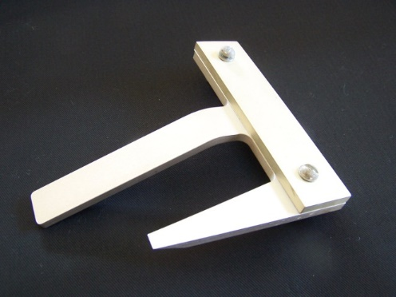
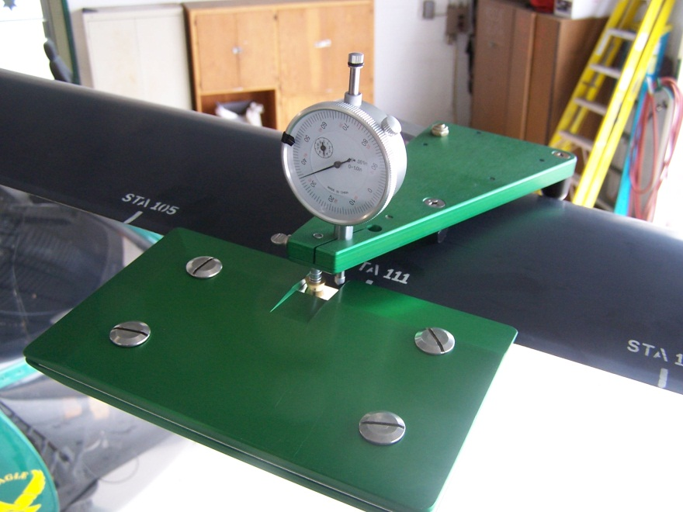
TAB TOOLS
Most tabs are measured in degrees
Newer designed tools measure tab displacement in Mils
Beware! Some Eurocopter tools measure up tab in MINUS degrees opposite to industry standards

Slide 27
LATERAL VIBRATION
Due primarily to imbalance in the rotor plane of rotation

Slide 28
SYNCRONIZING EVENTS
Typically a magnetic pickup is triggered by a ferrous interrupter
Must be ferrous
Requires a close proximity
.050” Typical

Slide 29
MAGNETIC PICKUP
Syncronizes Strobex
Syncronizes blade order for optical trackers
Provides a reference point from which phase angle is derived
Sets band pass filtering for accelerometers

Slide 30
MAGNETIC PICKUP
Magnetic pickup identifies master blade from which adjustments are referenced
Screw this up and you are in for a long day

Slide 31
Photocell as a one per rev trigger

Slide 32
Photocell
Triggers off reflective tape
Require “dwell”
Time.

Slide 33
MAIN ROTOR SMOOTHING SEQUENCE
For articulated rotors…
Ground track
Hover track
Inflight track
Balance
Check and adjust autorotation

Slide 34
MAIN ROTOR SMOOTHING SEQUENCE
For semi rigid rotors…
Ground track
Hover track
Hover balance
In flight track
Check and adjust autorotation

Slide 35
Main rotor strategies
Go for broke with all adjustments
Good for minor touch up
Disastrous for new blades
Familiarity with rotor essential
OK with later smart chart algorithms that have proven track record

Slide 36
Main rotor strategies
Sequential adjustments
Best bet for new blades
Slower than go for broke (maybe)
Easier to diagnose rotor problems
Can be used with smart technologies

Slide 37
Helpful hints
Record all readings and adjustments
Try to replicate readings on adjustment removal
Verify correct direction checking against track picture
Have same mechanic make the changes
Do not deviate from airspeeds or flight conditions when taking reading results.

Slide 38
Processors and Analyzers
Q: Why aren’t we talking about the instruments that process the signals?
A: User and use preference

Slide 39
Processors
Salient points
Cheaper balancers put more burden on user experience and qualification. They are more generic and not bound to specific software.
Expensive Balancer / Processors are typically more capable and lend themselves to data archiving and data bases. Tied to aircraft specific software.
BOTH CAN DO A FINE JOB OF EOTOR SMOOTHING

Slide 40
TAIL ROTOR
Generally treated s a single plane balance
More susceptible to sympathetic resonance making balance difficult

Slide 41
TAIL ROTOR
Small weight changes can have a large effect!
Weigh weight accurately
Feather bearings and trunnion preload are biggest problem.

Slide 42
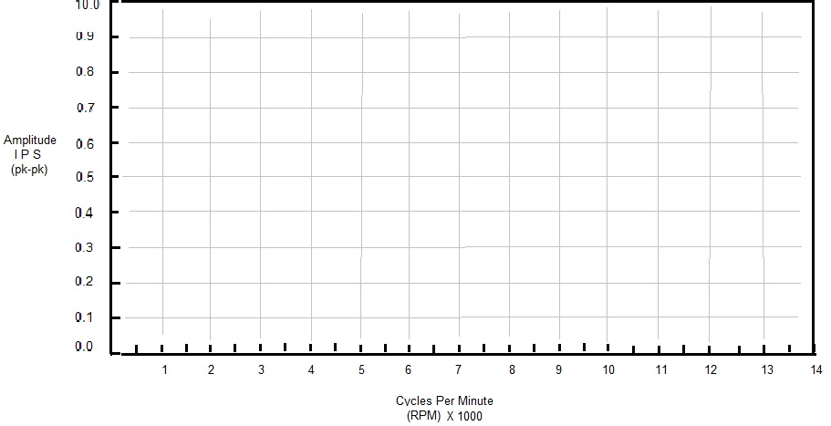
SPECTRUM ANALYSIS
Vibration spectra consist of frequency on the X axis (increasing left to right), and amplitude (amount) on the Y axis – bottom to top.

Slide 43
Frequency Identifies Component
Main Rotor 487 @ 100%
Eng N1 50790
Eng N2 33,000
Eng Output 6000
TR DS 2120
TR 2900
TR 2 rev 5800
Main bevel Gear mesh ~22000
PTO Gear mesh 301000
TR gear mesh 65000

Slide 44
Tying it together

Slide 45
Spectrum Analysis
Think in terms of Cycles per minute instead of RPM
Gear box gear mesh rates can be very high

Slide 46
How to use Spectrum to your advantage
One time shot
If you know exceedance amplitude numbers you know exactly what to look at to correct
Digital media can be shared among other technical staff
Largest peaks are generally what you feel
Try to standardize on locations
Can be compared to other aircraft

Slide 47
How to use Spectrum to your advantage
Sequence of data over time
It is always best to judge an aircraft against itself
Trends can be monitored over the aircrafts history
Interval has to be short enough to catch incipient problems
Interval has to be long enough to allow helicopter to change

Slide 48
How to use Spectrum to your advantage
Health and Usage monitoring
Can provide real time monitoring
Requires a substantial investment in equipment (per aircraft) and personnel (someone has to look at and judge serviceability)
Cost effective for large aircraft or where down time needs to be minimized

Slide 49
Q & A
This presentation has been brought to you compliments of Helicopter Technology Company, Los Angeles, California
See us at Booth C4302

